Slide 1
Chapter 7
Organizations and Information Systems
Notes:
This chapter explores processes and their supporting information systems within levels of an organization.
Investigate three types of processes and the scope of information systems that they use; investigate the concept of process quality and explain how information systems can be used to increase it; discuss how the use of information systems at one level of organization leads to information silos, explain the problems of such silos, and show how those problems can be solved by information systems at the next level of organization; discuss how enterprise systems such as CRM, ERP, and EAI; wrap up by showing how interenterprise IS can solve problems of enterprise-level silos. Finally, in 2026, discuss the implications of mobility and the cloud on future enterprise and interenterprise IS.

Slide 2
“How Much Money Does a System Own?
Who do we sell PRIDE to, and how do we induce them to buy?
Doctors?
Care about medicine and operations, some care about costs
Not focused on exercise
Insurance companies?
Exercise doesn’t prevent disease
When you get in good shape, you last longer, and their care expenses increase
Notes:
Provide a setting for students “to assess, evaluate, and apply emerging information technology to business.” (One of the major goals of the text from Chapter 1.)
Connect applications of IS to the fundamentals presented in Chapters 1–6.
Show a realistic application of mobile + cloud technology.
Demonstrate the need for, the creation of, and some of the issues involving an inter-enterprise IS.
Illustrate one realistic outcome for a startup … the originator, here Dr. Flores, cannot make a go of it, so an investors buys it for pennies on the dollar and changes the strategy. Will there be success?

Slide 3
Who Will Pay?
Health clubs
Employers
Selling ad space to health clubs and manufacturers
Social media–driven
Can PRIDE support 10,000 people spinning at the same time?
How to monetize PRIDE?
Needs a revenue model
Notes:
PRIDE might need a revenue model based on use. If they can get enough people using PRIDE in large groups. Could some social media–driven events attract enough users?

Slide 4
Study Questions
Q1: How do information systems vary by scope?
Q2: How do enterprise systems solve the problems of departmental silos?
Q3: How Do CRM, ERP, and EAI support enterprise systems?
Q4: How do inter-enterprise IS solve the problems of enterprise silos?
How does the knowledge in this chapter help you?

Slide 5
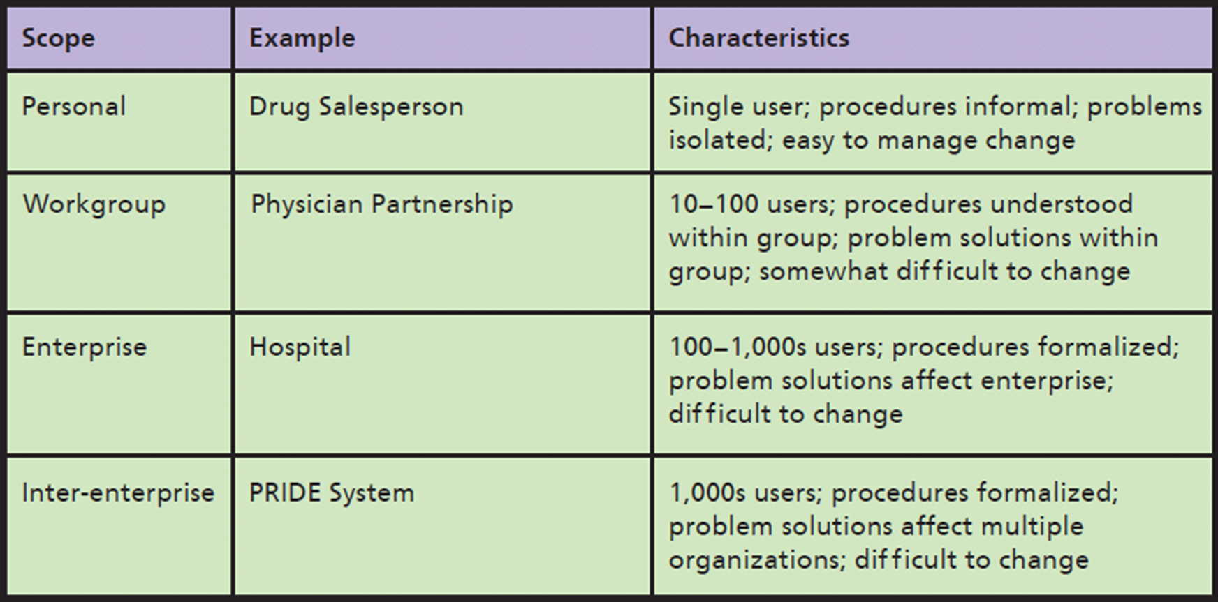
Q1: How Do Information Systems Vary by Scope?
Notes:
This is a simplified view of a three-activity process for approving customer orders.

Slide 6
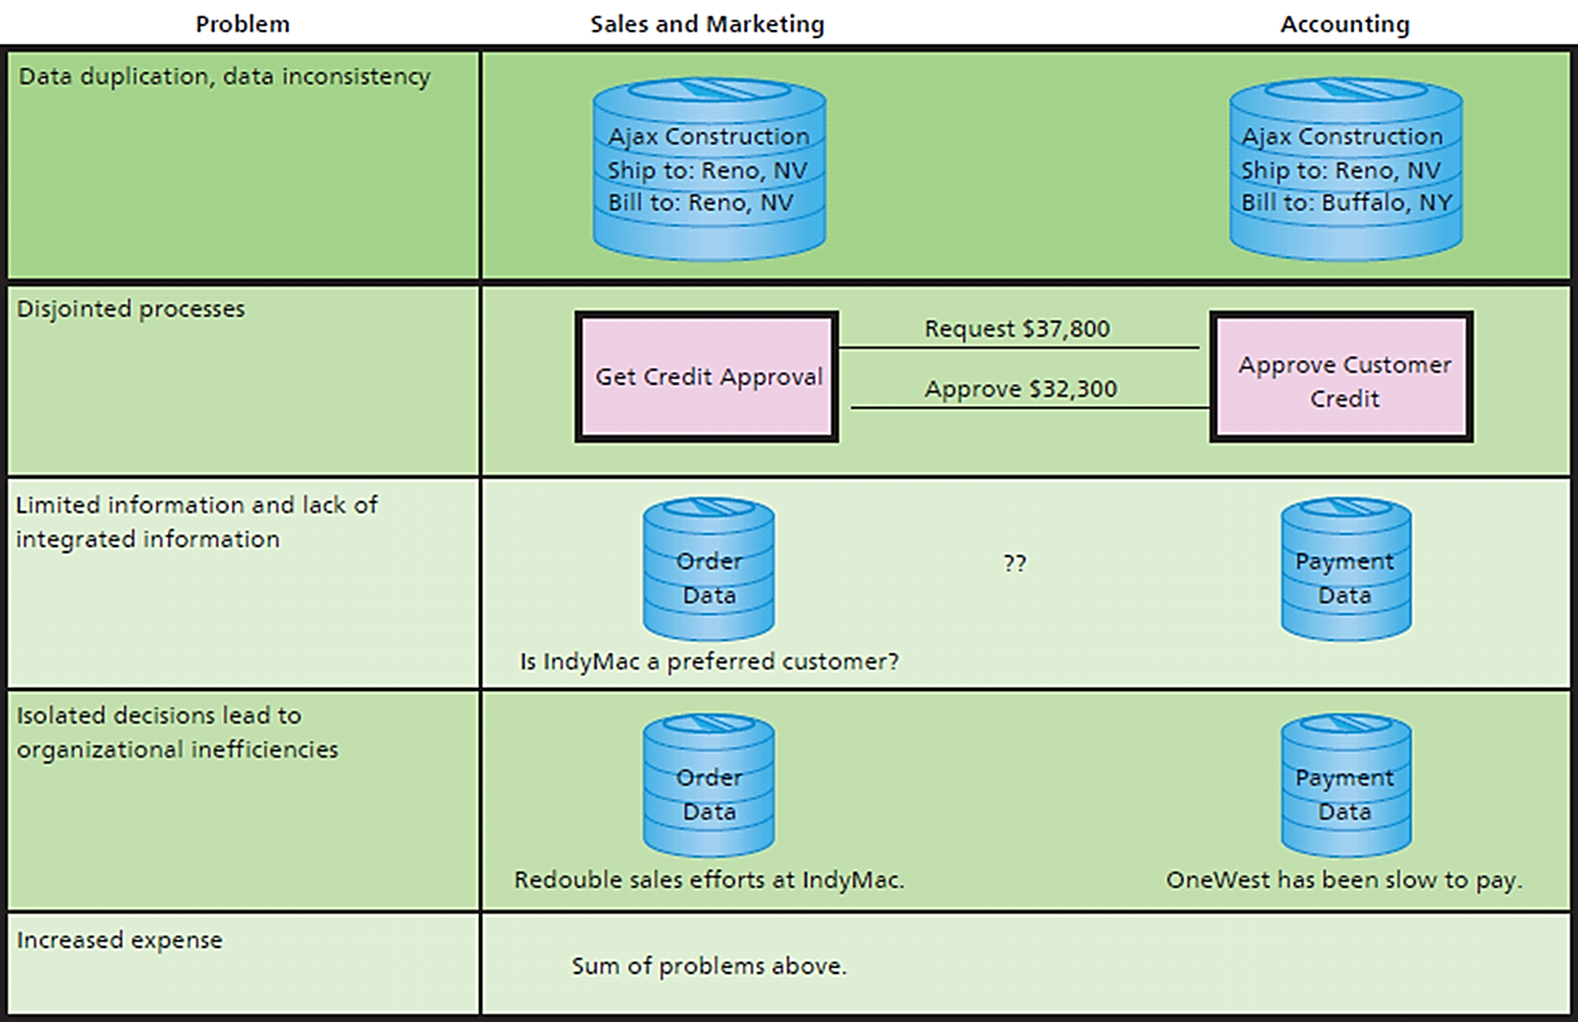
Q2: How Do Enterprise Systems Solve the Problems of Departmental Silos?
Notes:
Problems created by silos;
Data are duplicated which causes data duplication.
When applications are isolated, business processes are disjointed.
A consequence of such disjointed activities is the lack of integrated enterprise information.
seconds. This leads to inefficiency from making decisions in isolation.

Slide 7
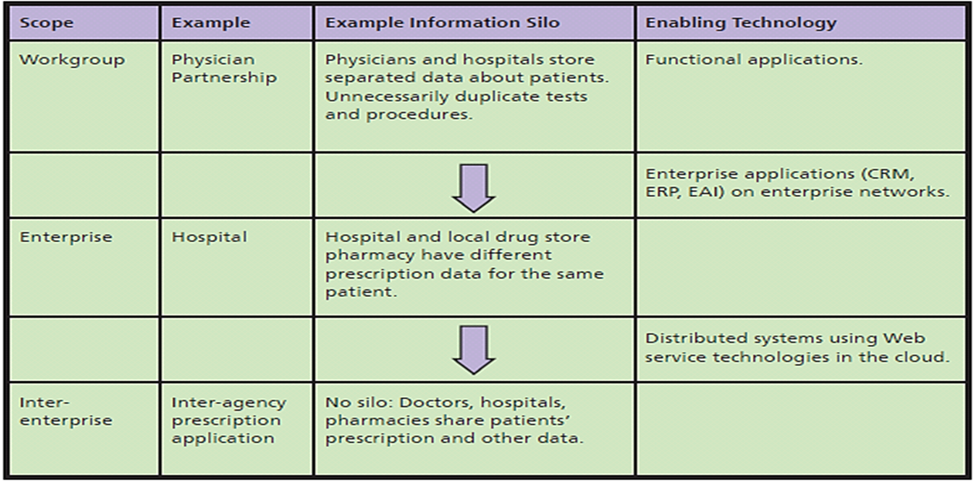
Information Silos as Drivers
Integrate data into single database
Revise applications
Allow isolation, manage to avoid problems
Notes:
The arrows in Figure 7-4 show this resolution at two levels of organization.
First, isolated data created by workgroup information systems are integrated using enterprise-wide applications.
Second, today, isolated data created by information systems at the enterprise level are integrated into inter-enterprise systems using distributed applications (such as PRIDE).

Slide 8
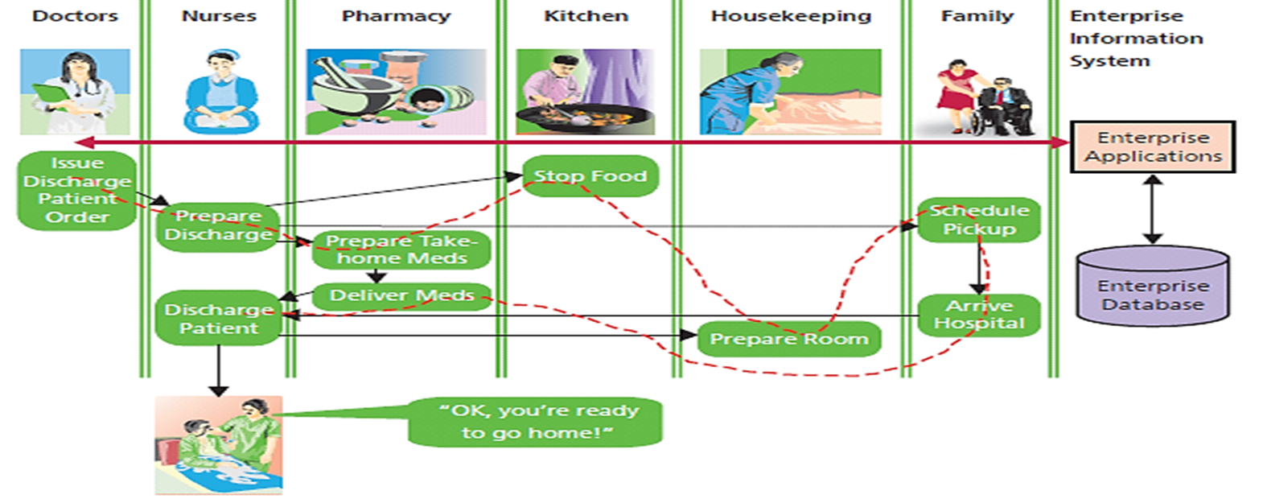
Some of the Departments Involved in Patient Discharge
Notes:
Hospital uses an enterprise-wide information system to support this process. IS provides data entry forms, reports, and notifications to human actors in this process. It also controls the flow of process activity as shown by dotted arrow.
To use new system, staff needs to transition from a paper-based system to computer-based one.

Slide 9
Business Process Reengineering
Enterprise systems enabled creation of more efficient or more effective processes
How can processes be improved?
Change process structure
Change process resources
Change both
Notes:
People use processes to organize and perform an activity to achieve an organization’s goals.
Two dimensions of process quality are efficiency and effectiveness.

Slide 10
Business Process Reengineering (cont’d)
Integrated data, enterprise systems create stronger, faster, more effective linkages in value chains
Difficult, slow, exceedingly expensive
Key personnel determine how best to use new technology
Requires high-level and expensive skills, and considerable time
Notes:
Hospital needed to determine how best to change its processes to take advantage of new capability.

Slide 11
Q3: How Do CRM, ERP, and EAI Support Enterprise Systems?
Inherent processes
Predesigned procedures for using software products
Based on “industry best practices”
Customer relationship management (CRM)
Enterprise resource planning (ERP)
Enterprise application integration (EAI)
Notes:
Organizations can license software and obtain prebuilt procedures. Over time, three categories of enterprise applications have emerged: customer relationship management, enterprise resource planning and enterprise application integration.

Slide 12
Customer Relationship Management (CRM)
Suite of applications, database, and set of inherent processes
Manage all interactions with customer through four phases of customer life cycle
Marketing
Customer acquisition
Relationship management
Loss/churn
Supports customer-centric organization

Slide 13
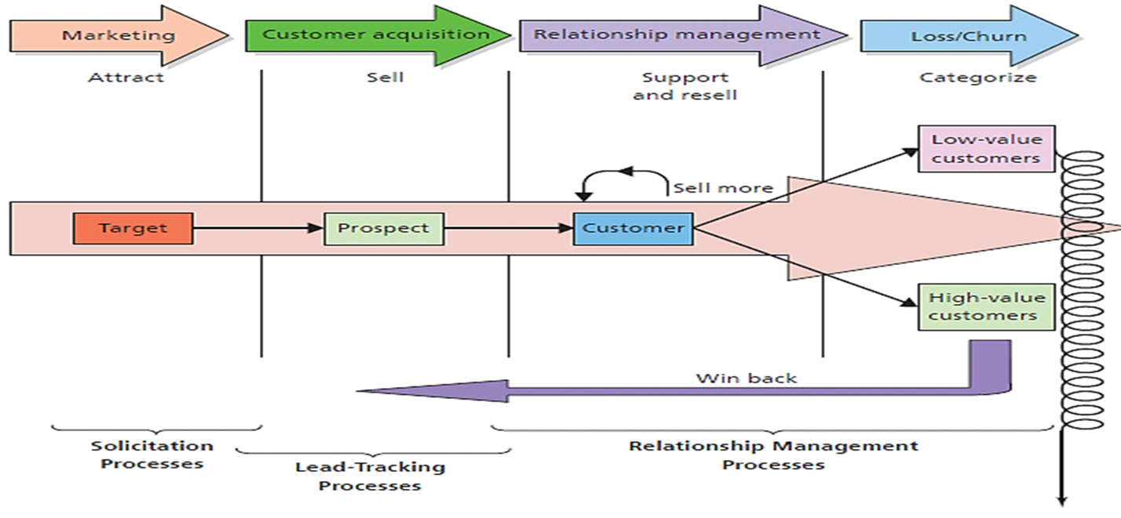
Customer Life Cycle
Notes:
Notice that components exist for each stage of the customer life cycle. As shown, all applications process a common customer database. This design eliminates duplicated customer data and removes the possibility of inconsistent data.
Marketing sends messages to target market to attract customer prospects. When prospects order, they become customers who need to be supported. Additionally, relationship management processes increase the value of existing customers by selling them more products.
Over time, organization loses some customers. When this occurs, win-back processes categorize customers according to their value and attempt to win back and turn them into high-value customers.

Slide 14
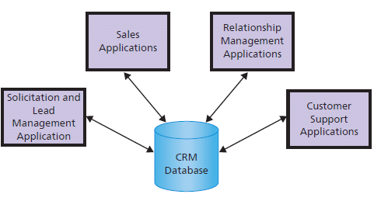
CRM Applications
Notes:
CRM components exist for each stage of the customer life cycle. As shown, all applications process a common customer database. This design eliminates duplicated customer data and removes the possibility of inconsistent data. It also means that each department knows what has been happening with the customer at other departments.

Slide 15
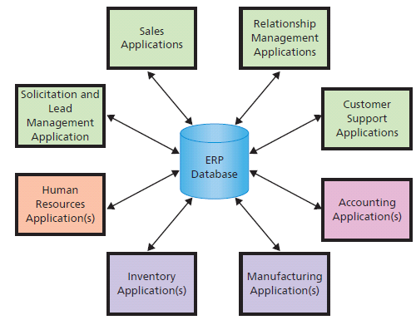
ERP Applications
Primary purpose integration
Notes:
ERP is a suite of applications (modules), a database and a set of inherent processes for consolidating business operations into a single, consistent, computing platform. ERP systems are an IS based on ERP technology.

Slide 16
Purpose of ERP Systems
Suite of applications, database, and inherent processes
Consolidates business operations into a single, consistent computing platform
CRM plus accounting, manufacturing, inventory, and human resources applications
SAP offers industry-specific customize packages
Notes:
ERP — Suite of modules, a database, and set of inherent processes for consolidating business operations into a single, consistent computing platform

Slide 17
Enterprise Application Integration (EAI)
Connects system “islands”
Enables communicating and sharing data
Provides integrated information
Provides integrated layer on top of existing systems while leaving functional applications “as is”
Enables less expensive, gradual move to ERP
Notes:
EAI is a suite of software applications that integrates existing systems by providing layers of software that connect applications.

Slide 18
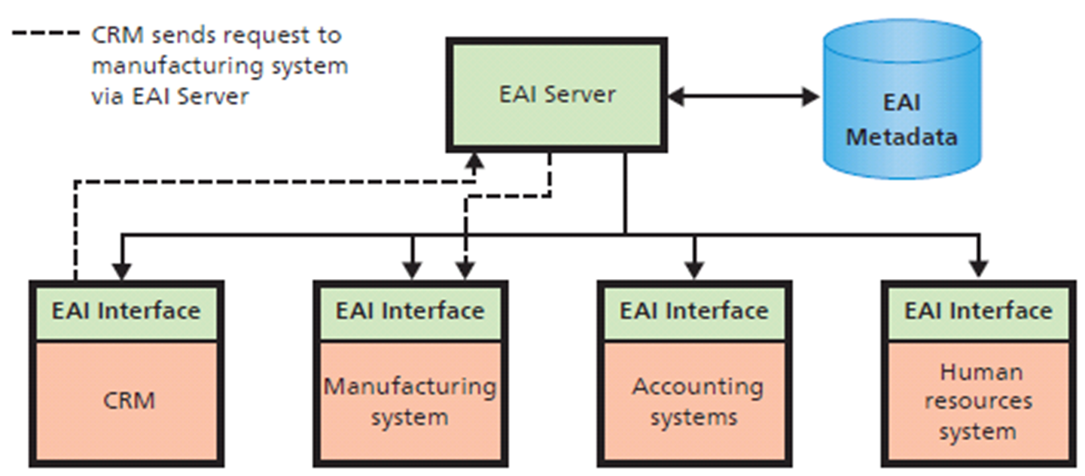
Design and Implementation for the Five EAI Components
Virtual Integrated Database
Notes:
EAI enables organizations to use existing silo applications while eliminating many serious problems of isolated systems.

Slide 19
What Are the Challenges of Implementing and Upgrading Enterprise Information Systems?
• Collaborative management
No clear boss
• Requirements gaps
Features and functions of complex, not easy to identify
What to do? Adapt or alter?
• Transition problems
Careful planning, substantial training, senior management involvement
• Employee resistance (Expect it)
• New technology
Notes:
Implementation is challenging, difficult, expensive, and risky. It is not unusual for enterprise system projects to be well over budget and a year or more late.

Slide 20
What Are the Challenges of Implementing and Upgrading Enterprise Information Systems?
• Employee resistance
Change requires effort and engenders fear
Threat to self-efficacies
Extra inducements needed
• New technology
The Cloud, mobile technology
Pose risks and potential outside control of organization resources
Notes:
Implementation is challenging, difficult, expensive, and risky. It is not unusual for enterprise system projects to be well over budget and a year or more late.

Slide 21
So What? Workflow Problems
“Most IT problems are workflow problems, not software problems”
Who fixes a workflow problem?
Someone with knowledge of business processes
Need knowledgeable business people comfortable working with technical people
You and a business analyst
Notes:
To do this well, you need to know IS and something: IS and marketing, IS and operations, IS and finance.

Slide 22
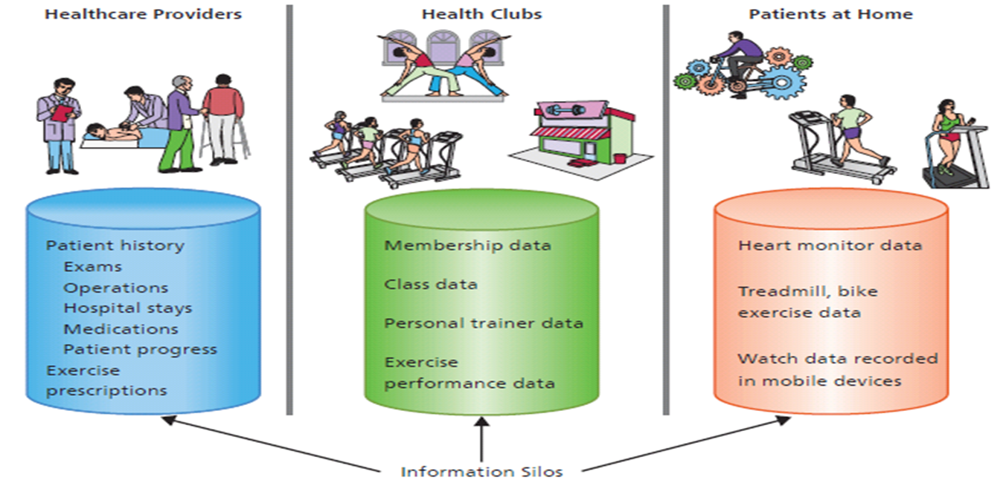
Q4: How Do Inter-enterprise IS Solve the Problems of Enterprise Silos?
Information Silos of
PRIDE
Notes:
Figure 7-10 shows the information silos that exist among healthcare providers, health clubs, and patients, the principal PRIDE users.
Isolation of data causes problems. Doctors want reports on exercise data stored on patient devices and in health clubs. Patients want prescription data from their providers as well as exercise data from their health clubs. Health clubs want exercise prescriptions and home workout data to integrate with data they have.

Slide 23
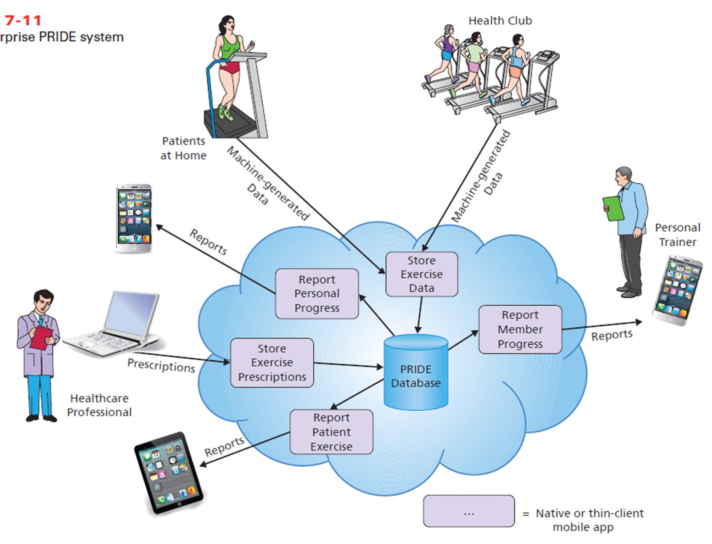
Inter-enterprise PRIDE System
Distributed Systems
Notes:
PRIDE is a distributed system because processing is distributed across multiple computing devices. Standards such as http, https, html5, CSS3, JavaScript, and others enable programs on varied and disparate devices to flexibly communicate with cloud servers and database, and indirectly communicate with each other.

Slide 24
How Does the Knowledge in This Chapter Help You?
Understand levels of information systems and problems
Gain perspective information systems and understand issues of information silos
Know what CRM, ERP, and EAI applications are, what they do, and some issues involving use and implementation
Background for investigating use of the cloud for applications

Slide 25
Ethics Guide: Dialing for Dollars
Assume you are a salesperson
Bad quarter. VP of sales authorized a 20% discount on new orders if customers take delivery prior to end of quarter so order can be booked for this quarter.
VP says “Start dialing for dollars, and get what you can. Be creative.”
Notes:
Goals
Understand how business pressures motivate people to act unethically and sometimes illegally.
Discuss ethical principles among three different aggressive sales techniques.
Illustrate how deception in the use of an interdepartmental information system may cause unintended consequences.

Slide 26
Unethical, Violate SEC Rules, or Fraudulent
1. Side letter
2. Delayed discount
3. Fictitious account
Send email with return product agreement
Offer product at full price but agree to give 20% credit next quarter
Sell to fictitious company and ship product to your brother-in-law’s garage
Notes:
Software industry has used all three techniques in this guide, especially during the 1990s and early 2000s. These techniques, when applied to distributor customers, are often referred to as “stuffing the channel.” It’s a risky strategy because the company is pushing this quarter’s problem into next quarter. Unless there is a substantial increase in sales demand, problem will grow worse.
Managers do it to delay stock price slaughter for at least one quarter. The techniques presented are all unethical. First and third violate SEC rules and regulations, while second is criminally fraudulent.

Slide 27
Security Guide: One-Stop Shopping
IS design involves constant trade-offs
Risk of loss is higher, security can be focused
Inter-enterprise system can connect competitors with different incentives and agendas
How secure is the cloud vendor?
Bitcoin
Centrally located, accessible from anywhere, very large sum of electronic money
Notes:
Goals
Understand potential security problems of integrating data into a single database, whether in enterprise or inter-enterprise systems.
Realize security and privacy issues when inter-enterprise systems integrate competitors (as PRIDE must do to accomplish its purpose).
Underline some of the management challenges inherent in inter-enterprise systems.
Introduce caution about cloud security.
Remind students, again, of the need for using strong passwords.

Slide 28
Active Review
Q1: How do information systems vary by scope?
Q2: How do enterprise systems solve the problems of departmental silos?
Q3: How Do CRM, ERP, and EAI support enterprise systems?
Q4: How do inter-enterprise is solve the problems of enterprise silos?
How does the knowledge in this chapter help you?

Slide 29
Case Study 7: Interorganizational IS – The National Programme for IT in the NHS Experience
The NPfIT – the two major components of the system:
Electronic Sharing of X-rays System (ESXS)
Electronic Patient Record System (EPRS)
ESXS
Involvement of health professionals, clinical requirements understood, good planning and organization
EPRS
Political motivation, lack of health/IT professional involvement
Notes:
Goal
Have students to create a process diagram similar to Figure Q27
See the questions at the end of the case for exercises to assign to students

Slide 30
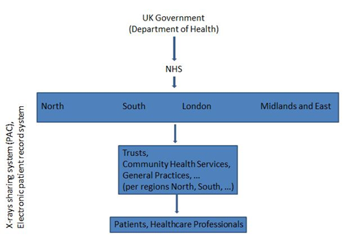
NPfIT Inter-organizational IS

Slide 31
Electronic Sharing of X-rays System
The computer accessible X-ray system was delivered smoothly
On budget
On time
The X-ray system was a rare product of consultation with health professionals
The X-ray system was added to the NPfIT after the original specifications were drawn up
Notes:
Discuss IS development success factors and common failure factors.

Slide 32
Electronic Sharing of X-rays System (cont'd)
The system was successfully rolled out and delivered to all parts of the NHS organization in 2007
Full buy-in with respect to all stakeholders
Requirements met clinically as well as organizationally
X-ray sharing system an exemplar for other projects and systems within the NPfIT

Slide 33
Electronic Patient Record System
Still far from completion by 2011
Substantial further investment required for completion 2015-2016
Functional specification reduced
Timescales and cost savings would have been largely unaffected

Slide 34
Electronic Patient Record System (cont'd)
Forensic examination of the time and budget over-runs undertaken by National Audit Office (NAO)
Several factors contributed to these:
motives
buy-in
haste
multi-sourcing
End result: Electronic Patient Record System development failed
Notes:
Explain problem of time-and-materials contract problems using home construction example.

